Slide 1



Custodian Banks & Reconciliations

Slide 2

DISCLAIMER
The training content and delivery of this presentation is confidential, and cannot be recorded, or copied and distributed to any third party, without the written consent of Imarticus Learning Pvt. Ltd.

Slide 3

YOU ARE GOING TO LEARN…
Custodian Bank & their Role & Functions
Types of Custodian Bank
Reconciliation & its Purpose
Importance of Recon
Recon Process
Types of Recon
Internal
External

Slide 4

CUSTODIAN
A custodian is a financial institution responsible for safeguarding a firm’s or individual’s financial assets
When an institutional investor invests in securities it will commonly employ the services of a custodian.
This is because a custodian provides various activities which will support not just the trading function, but also the operational activities involved in the transaction.

Slide 5
SERVICES PROVIDED BY A CUSTODIAN
Legal, compliance and tax support services
Settlement of any purchases and sales
Deliveries in/out of securities and currencies
Lend and/or borrow securities
What more does a custodian do?
Safekeeping assets, securities, bank accounts and cash, and warehouse receipts
Maintain currency/cash bank accounts, margin accounts, comply with collateral management requirements
Voluntary and involuntary corporate actions

Slide 6

REPORTING AND RECORDKEEPING
Part of any custodian’s business strategy is to provide its customers with recordkeeping and reporting services. Services include:
Meet the customers’ specialized needs
Comply with applicable recordkeeping and reporting laws and regulations
Generate customized customer reports
Generate regulatory and legal reports
Multicurrency recordkeeping and reporting capabilities
Tax reporting and financial accounting
Daily reports of their activity in domestic stocks and bonds, foreign securities, derivatives, options, or other unusual investments
Meet Bank Secrecy Act; recordkeeping and confirmation requirements for securities transactions, and other applicable laws related to record retention

Slide 7
TYPES OF CUSTODIANS
Term | Description | Example
Custodian | An organisation that holds securities and cash on its clients behalf and may effect trade settlement on its client behalf | Deutsche Bank Domestic custody services
Global Custodian | As per custodian, but has a network of local(or sub-custodian) that hold securities and cash and effect trade settlement on behalf of the global custodian | State Street , Citigroup, BoNY, Paribas
Local Custodian | A custodian that operate with in a specific financial center | Credit Lyonnais Paris, Banco Espirito Santo Lisboa
Sub -custodian | A custodian within a Global custodians network of custodians | Citibank Milan Citibank Madrid

Slide 8




GLOBAL CUSTODIAN
A global custodian provides investment administration for investor clients, including processing cross-border securities trades and keeping financial assets secure (i.e., providing safe custody) outside the country where the investor is located.
Some global custodians maintain an extensive network of branches globally and can meet the local custody needs of their investor clients by employing their own branches as local custody providers.
Citi maintains a proprietary branch network covering 57 markets
Few Global Custodians

Slide 9



SUB/LOCAL CUSTODIAN
A sub-custodian effectively serves as the eyes and ears of the global custodian in the local market, providing a range of clearing, settlement and asset servicing duties
Will lobby the market authorities for reforms that will make the market more appealing and an efficient target for foreign investment.
In locations where a global custodian does not have its own branch, a global custodian may appoint an external agent bank to provide local custody services
Few Sub/Local Custodians

Slide 10
WHAT IS RECON?
Reconciliation is the Control Process by which 2 or more sets of data are compared and any discrepancies are investigated and documented through to resolution, including formal reporting and escalation.
Reconciliation of positions and trades within internal books and records with the outside world is of utmost importance in ensuring that any Bank remains in Control of its assets and liabilities
The primary purpose of reconciliation is to identify and resolve any differences between the two sets of records, which may arise due to various factors such as errors, omissions, or timing differences.

Slide 11
WHY RECON?
Irrespective of what part of the company you are involved with, you will always need to know what your positions are, whether they are securities-related or cash-related. A problem arises when the position that you think you have either does not exist or indicates a different amount to what you actually have. In other words, you need to be sure that the position you think you have does actually exist
Total Position for securities total balance for cash can go wrong, if the individual transaction for cash and securities goes wrong.

Slide 12
PURPOSE OF RECONCILIATION
Here are some key aspects and purposes of reconciliation:
01
Verification of Accuracy
Reconciliation is used to verify that the data or transactions in one set of records match those in another set. This is done to ensure that all information is accurately recorded and accounted for
02
Identification of Discrepancies
During the reconciliation process, any discrepancies or differences between the two sets of records are identified. These discrepancies could be in the form of missing items, incorrect amounts, or other inconsistencies.
03
Resolution of Differences
Once discrepancies are identified, the reconciliation process typically involves investigating the root causes of the differences and taking corrective actions to resolve them. This may involve making adjustments, corrections, or further investigations to rectify the issues.
04
Enhanced Transparency
Reconciliation enhances transparency by providing a clear and documented record of the steps taken to ensure data accuracy. This is important for audit and compliance purposes.

Slide 13
PURPOSE OF RECONCILIATION
05
Risk Management
Reconciliation is an essential part of risk management. It helps mitigate operational and financial risks by identifying and rectifying errors and discrepancies before they can have a significant impact.
06
Financial Reporting
In accounting, reconciliation is crucial for producing accurate financial statements. It involves comparing the general ledger with subsidiary ledgers, bank statements, and other financial records to ensure that the figures match.
Overall, reconciliation is a systematic and methodical process that contributes to the accuracy, transparency, and integrity of financial and operational data. It is essential in various business contexts to maintain trust, meet regulatory requirements, and ensure the proper functioning of financial and operational systems.

Slide 14
EXAMPLE OF WHY RECON?
As an example of a potential problem, your records show that you have USD 1,000.00 in your bank account. You receive a bank statement showing a credit balance of USD 1,000.00. You then make a payment of USD 900.00 on the assumption that you have sufficient funds in your account.
Thinking that you have a credit balance of USD 1,000.00, you are surprised when you receive a subsequent statement stating that you are several hundred US dollars overdrawn. In addition to being overdrawn, you will be liable for overdraft interest. Why are you overdrawn? What has gone wrong on your bank account?
This is where a reconciliation would have been helpful. A thorough investigation would have shown, for example, that you had recently issued a cheque for USD 350.00 but failed to book it into your records. Had you done so, your records would have shown a balance of USD 650.00 (not USD 1,000.00), and it would have been clear that making the payment of USD 900.00 would have taken your account into debit (i.e. overdrawn).
The fact that the cheque had not cleared only made the situation worse, as you looked at the bank balance before deciding to pay the USD 900.00.

Slide 15
IMPORTANCE OF RECON
It serves several critical purposes that contribute to the accuracy, transparency, and efficiency of an organization's activities. Here are some key reasons why reconciliation is important:
Accuracy and Data Integrity: Reconciliation helps ensure that financial and operational data is accurate and reliable. By comparing and verifying records, discrepancies, errors, and omissions can be identified and corrected, preventing inaccuracies in financial statements and reports.
Risk Mitigation: Reconciliation is a key component of risk management. It helps identify and address errors and discrepancies before they can lead to financial losses, compliance issues, or other operational risks.
Compliance: In many industries, organizations are subject to regulatory and compliance requirements that mandate reconciliation processes. Compliance with these regulations is essential to avoid legal penalties and maintain the trust of stakeholders.
Transparency: Reconciliation enhances transparency by providing a documented trail of actions taken to ensure data accuracy. This transparency is essential for audits, regulatory reporting, and building trust with stakeholders.

Slide 16
IMPORTANCE OF RECON
Operational Efficiency: Accurate reconciliation processes lead to greater operational efficiency. They reduce the time and effort required to identify and rectify errors, resulting in a smoother and more efficient workflow.
Financial Reporting: In accounting, reconciliation is vital for producing accurate financial statements. It involves comparing general ledger accounts with subsidiary ledgers, bank statements, and other financial records to ensure that the figures match. Accurate financial reporting is essential for making informed business decisions and maintaining investor confidence.
Prevention of Fraud: Reconciliation can help identify discrepancies that may be indicative of fraudulent activities. When discrepancies are spotted and investigated, it becomes more difficult for fraudulent transactions to go unnoticed.

Slide 17
IMPORTANCE OF RECON
A fundamental loss of control … not knowing if …
The Settlement system has the full population of trades
Stock or Cash has been moved from the Bank’s account without one’s knowledge …
leading to …
Actual loss arising from Human/ Systemic error or Delays and Fraudulent activity (E.g. – Mis-posted failing trade; Inaccurate Redemption posting)
Poor Decision making arising from inaccurate information (E.g. – depot of delivery not having adequate quantity of a multi-listed security)
Inaccurate/ Mis-stated Financial Reporting (and subsequent SOX consequences) arising from Human/ Systemic error or Delays and Fraudulent activity (E.g. – Finance/ Product/ Trading Book control teams reconcile P/L on a daily basis)
Regulatory Censure/ Fines and subsequent Reputational impact (E.g. – breach of Client Money rules of the FSA)
Strained Client Relationships and/ or Loss of Client Revenue through Inaccurate reporting (E.g. - a Broken trade-by-trade reconciliation could lead to Inaccurate reporting of open trades to a Tier 1 client)

Slide 18
TYPES OF RECON
Accurate and timely reconciliation will ensure that both the Front Office and Operations will know, with a high degree of confidence, what their asset balances are and, just as importantly, where these assets are being held.
We can consider the concept of reconciliation from two points of view:
Comparing our internal records (our ledger) with those of an external entity (e.g. a bank statement, depot statement, broker statement etc.); - EXTERNAL RECON
Comparing within our own internal books between different departments/ different subsidiaries – INTERNAL RECON – Intra and Inter

Slide 19
RECON PROCESS
Reconciliation is a Control Process wherein:
2 or more INDEPENDENT sets of data elements are compared and matched.
The data elements need to be from 2 different sources.
If the data elements do not match, the differences are referred to as a ‘BREAK’ or discrepancy.
Breaks need to be investigated and Resolved.
Unresolved Breaks require Escalation to Management for attention and resolution.
The Breaks identified and the resolution process needs to be documented and reported.
Ageing of Breaks is a key RISK Management metric to monitor the progress of Break resolution.
Breaks can be matched even though there is not an exact match as long as the break values are within the established Tolerance levels. E.g. an accepted tolerance level for currency could be 5 USD.

Slide 20
TYPES OF RECON
Internal Recon
1. Intra System Recs (Presettlement)
Front Office Vs Middle Office
Front Office Vs Back Office
Middle Office Vs Back Office
2. Inter Company Recs
Our Books with Subsidiaries
Our Books Vs Group Companies
External Recon (Internal Vs External)
1. Depot/Stock Recs –
Internal System with external parties
It’s a post settlement recon of Stock
2. Nostro / cash Recs –
Internal System with external parties
It’s a post settlement recon of Cash

Slide 21
TYPES OF RECONCILIATION
Type | Involves | Comments
1. Trade-by-trade | Individual trades | Front Office positions vs. Operations' positions
2. Traded position | Totals of trades recorded within a trading book/for a client | Front Office positions vs. Operations' positions
3. Open trades | Individual trades | Operations' positions vs. custodian/broker/counterparty
4. Depot position | Totals of securities positions held within a trading book/for a client | Operations' positions vs. custodian
5. Cash position | Cash balances and movements within a nostro account | Operations' positions vs. custodian/bank
Internal Recon
External Recon

Slide 22
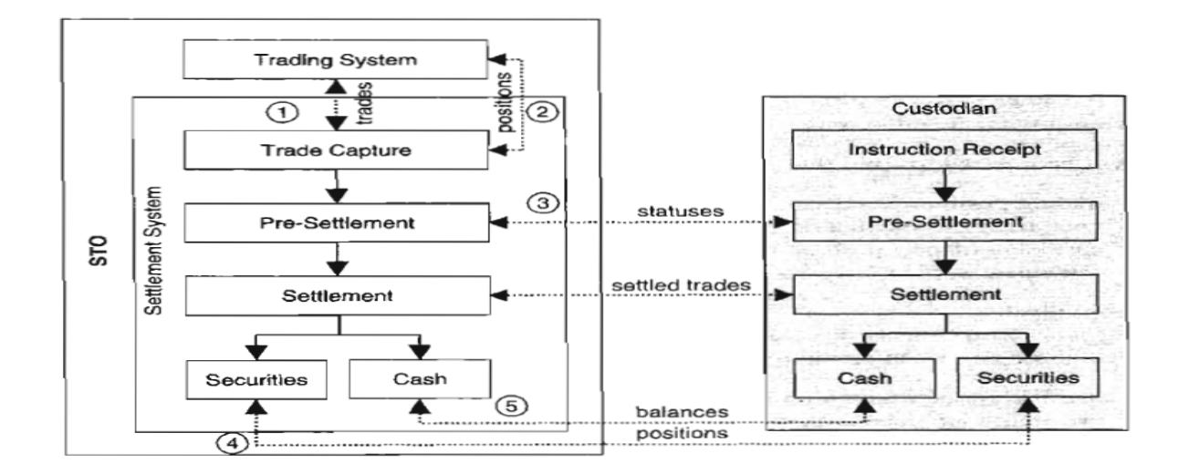
TYPES OF RECONCILIATION

Slide 23
TYPES OF RECONCILIATION
Types 1 and 2 are internal reconciliations that ensure the dealers' blotters agree with the settlement systems in the Operations Department.
Types 3, 4 and 5 are external reconciliations:
Type 3 handles both the asset and the cash counter-value;
Type 4 handles non-cash assets only;
Type 5 handles cash only.

Slide 24
INTERNAL RECONCILIATION - INTRA
Internal reconciliation is very important to any investment bank to resolve breaks that arise due to feed issues between the front-office and back-office systems
Sales support trade reconciliation (FO-FO)
Reconciliation between order management (sales system) and front office trading system
Front Office Trading to Risk Management system (FO-MO)
Automated reconciliation of data between both the systems to make sure risk system has captured all the trades. Any missing trades have to be escalated to respective Tech department, who would make sure all the trades are captured
Front Office Trading to Operation Systems (Intra) (FO-MO-Core Ops)
Reconciliation of data between front office and operations system is necessary to make sure all the trades are accurately captured in these systems.

Slide 25
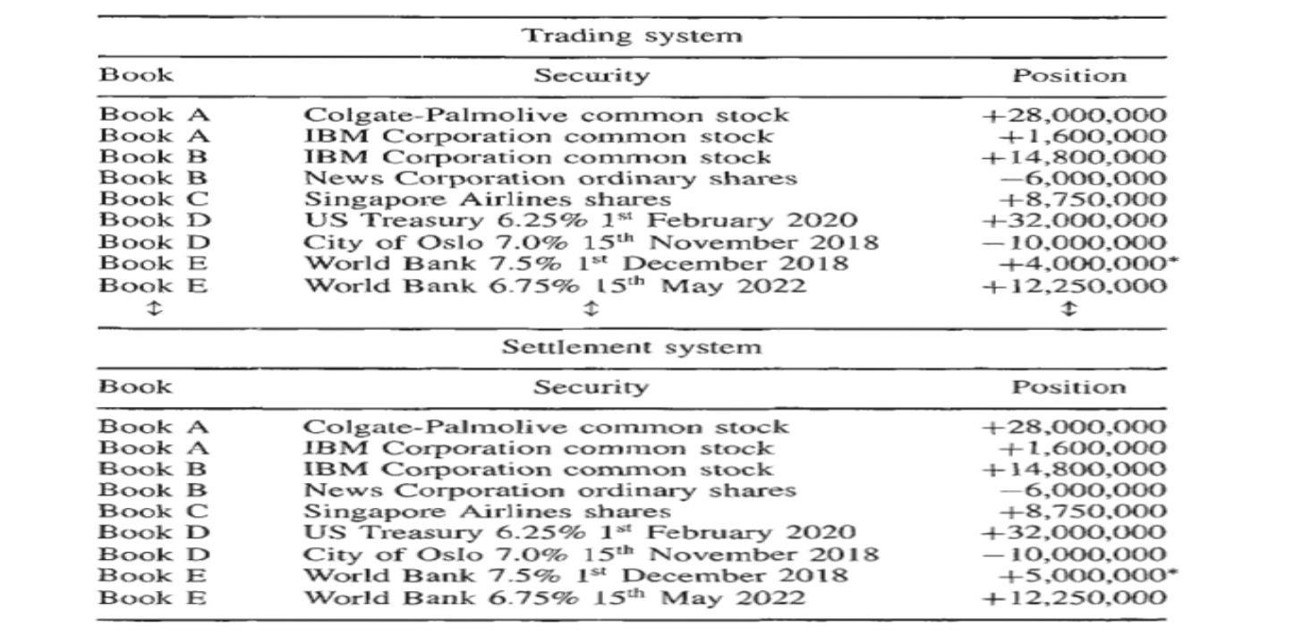
INTERNAL RECONCILIATION - INTRA
Position Reconciliation

Slide 26
INTERNAL RECONCILIATION - INTER COMPANY
Inter companies transactions are the movement of positions between two Internal IB Subsidiaries that are on the back of Financial Transactions. For e.g: ABN Amro Frankfurt agrees an FX trade with BAML NY. However, the ABN Amro Trader has his Profit Centre with ABN Amro Frankfurt. This will create an Intercompany Transaction.
01
The Intercompany reconciliations will cover all the trades between multiple subsidiaries to ensure that the positions between them are accurate. For E.g. ABN Amro Frankfurt agrees an FX trade with BAML NY.
02

Slide 27
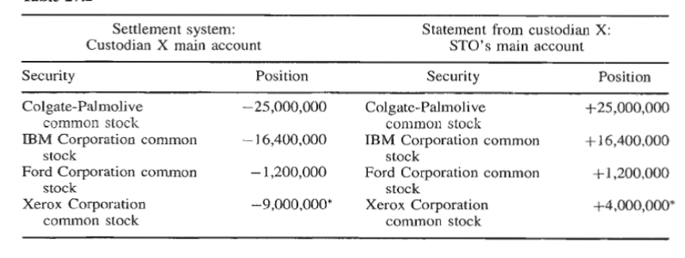
EXTERNAL RECONCILIATION WITH CUSTODIAN
Position Reconciliation

Slide 28
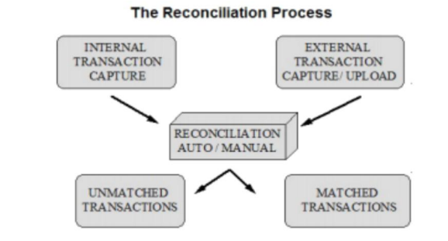
EXTERNAL RECONCILIATION WITH CUSTODIAN – NOSTRO ACCOUNT
In order to deal in the Foreign Exchange Market and transact in foreign currencies, banks maintain accounts with other banks globally. This is known as a Nostro Account. The Nostro reconciliations are an accounting process used to compare two sets of records to ensure that the figures are in agreement and are accurate, and is commonly used for currency settlement. Banks maintain accounts with other banks (Nostro Accounts) and it is necessary for them to reconcile Ledger account Statements with the Nostro Account Statements. The replica of Nostro account is maintained by the bank in its books or operational purposes and is known as a Nostro mirror account.
01
02
Ledgers: Entries generated internally (Nostro Mirror Account)
03
Statements: Entries from Nostro banks

Slide 29
EXTERNAL RECONCILIATION WITH CUSTODIAN – NOSTRO ACCOUNT
Through the process of reconciliation, banks can track the status of:
Cash received/receivable
Amount paid/payable
Track unsettled transactions either in mirror or in actual Nostro accounts
For instance, banks can ensure that their interbank cash flows from FX Spot, FX Forward, FX , Swaps, borrowings, placements, derivative have settled
Reconciliation helps in identifying unsettled/ discrepancy and transactions and helps in quick remedial action
04
Nostro Credit entries/Statement Credit are reconciled against internal debit entries/Ledger debit. Nostro Credit may arise due to:
Payments received on behalf of customers
Interest amount credited to nostro account
Receipts from interbank deals
05
06
Ensure that all the receipt settlements are acted upon by the correspondent bank and are reflected in the Nostro statement accordingly

Slide 30
EXTERNAL RECONCILIATION WITH CUSTODIAN – NOSTRO ACCOUNT
Nostro debit entries are reconciled against the internal credit entries/Ledger credit. Nostro debits may arise due to:
Honoring the payment messages sent by the bank/payment of draft issued by the bank
Charges debited in the Nostro accounts
Payments on account of interbank deals
07
Nostro Breaks Reasons –
Investment bank makes a payment to the client but the Nostro bank does not debit the account for the payment due to insufficient cash balance in the account.
Client pays incorrectly to the IB’s Nostro account which does not match any transactions that the IB has entered into.
08
Nostro Breaks Example – Ledger and Statement Breaks examples
09
Ledger | Statement
(+) $1,000,000 | NO ENTRIES
NO ENTRIES | (+) $7,000,000

Slide 31
EXTERNAL RECONCILIATION WITH CUSTODIAN – DEPOT ACCOUNT
Positions are reconciled to ensure positions/holdings are matching Internally (Trading system, accounting system and risk system) and Externally (Accounting vs Custodian books) on a daily basis.
01
Risk of Not Performing Reconciliations Failure to perform position recon can lead to:
Missed trade: Either the Investment manager or the custodian can miss recording trade or other transaction like dividend, interest etc. If this situation is not resolved the market value of the fund is not correct and the NAV of the portfolio can be misrepresented to clients, participants and portfolio managers.
Booking error: Trade incorrectly booked by custodian/Investment manager (Buy v/s Sell, Incorrect quantity, price etc.).
02
Financial and reputational issues: As the price of the security would have moved with the moving market, fixing the error at a later point in time could lead to losses and sometimes could damage the reputation.
03

Slide 32
EXTERNAL RECONCILIATION WITH CUSTODIAN – DEPOT ACCOUNT
Depot Beaks Reasons –
Securities not released to CP/Client due to insufficient shares in the depot account.
Securities received without trade being booked into the system.
04
Depot Breaks Example –
Ledger | Statement
10,000 shrs of Tesla Cr. | 9,500 shrs of Tesla Dr.
NO ENTRIES | 5,150 shrs of Apple Cr.
05

Slide 33
EXCHANGE AND OTC RECONCILIATION
Exchange Reconciliation
This type of reconciliation is done between Middle Office and stock exchange systems. This is to ensure that no order (parent or child order) is missing in the bank’s internal system. If orders are missing - this reconciliation will highlight any missing orders and the MO team has to work with FO Tech to ensure all trades have flown down into the systems.
01
OTC Reconciliation
There are several reconciliations done when an IB enters into a OTC transaction.
First the trade needs to be reported to the CCP within 15 - 30 mins. of entering into the transaction.
At EOD all transactions that were reported at BOD are reconciled to ensure that no transactions are missing.
02

Slide 34
WHY RECONCILIATION?
As we have discussed, a large financial institution does numerous types of reconciliation from Front Office to Back Office. Now let’s look at the reasons why Reconciliation is so important:
Avoiding Fraud - at all steps in the trade life cycle.
Accuracy of cash and stock movements.
Balancing investment positions.
Portfolio Management
Ensuring accuracy of Trades throughout the life cycle of a trade.
Managing Settlement and Reconciliation Risks
Matching Bank Statements with Internal Records
Detecting Errors and Unaccounted Transactions

Slide 35



THANK YOU !!!
Contact us today! https://imarticus.org/

